Slide 1
Alice Subaqueous - First Gallery
Senior Retrospective - Perpich Center for Arts Education

Slide 2
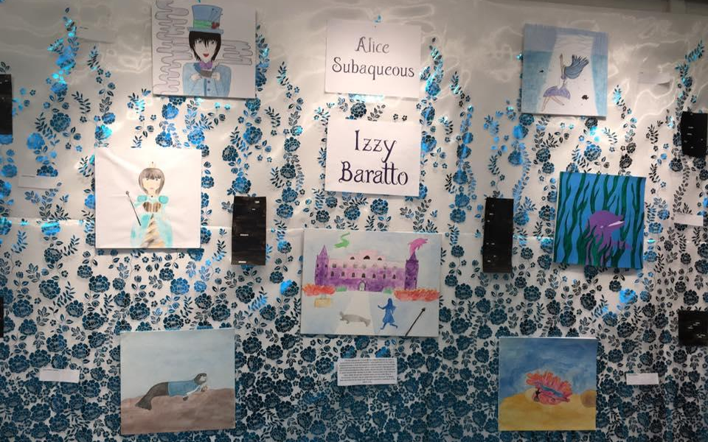
Alice Subaqueous
Overview

Slide 3
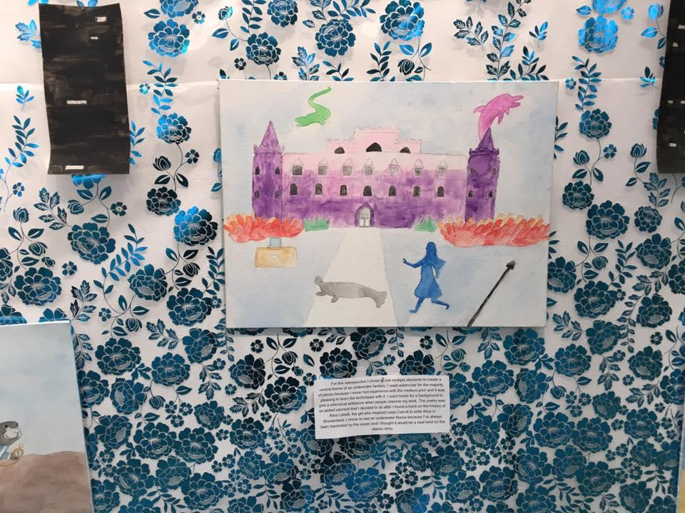
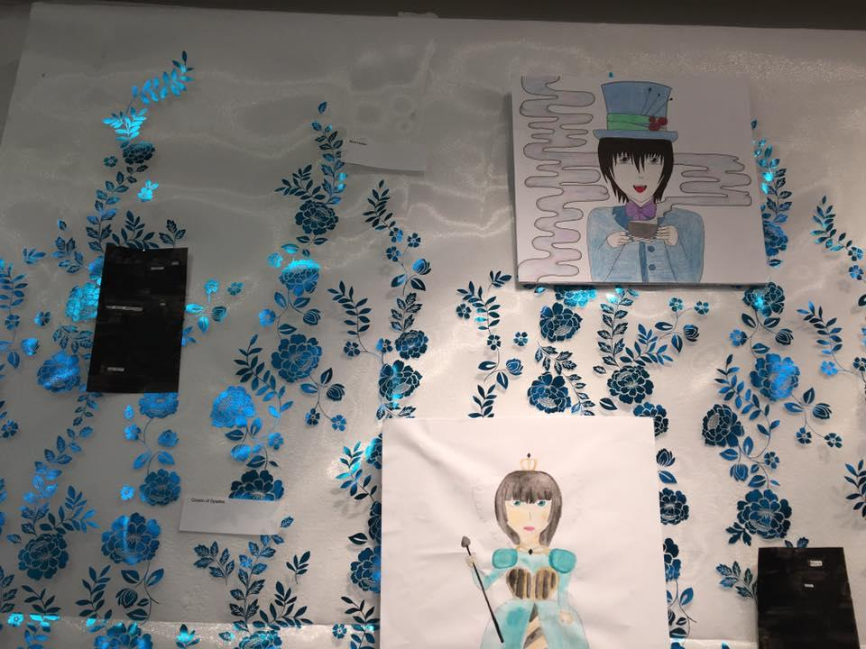
Alice Subaqueous Contd

Slide 4
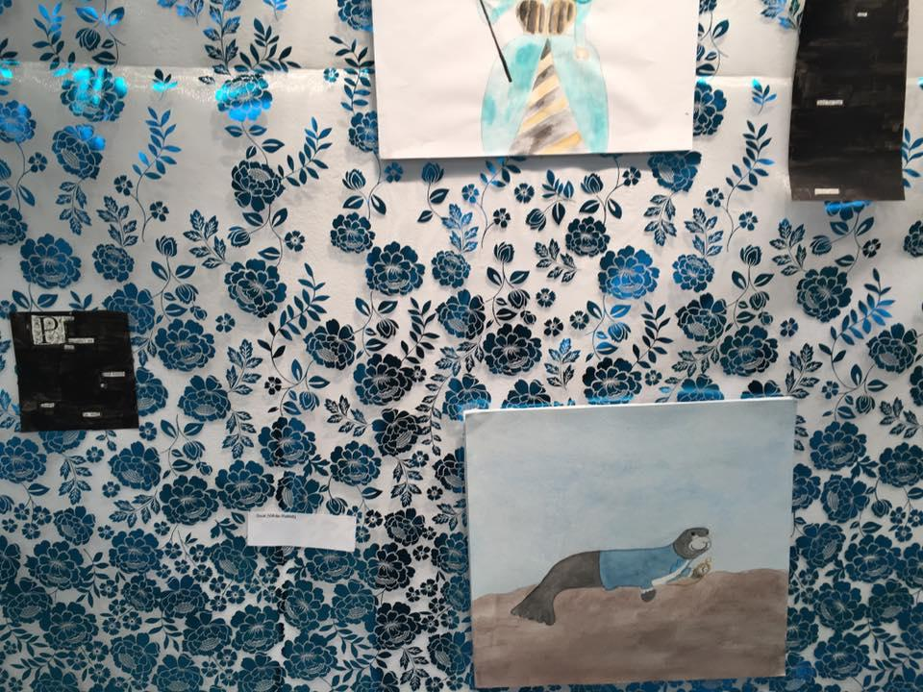
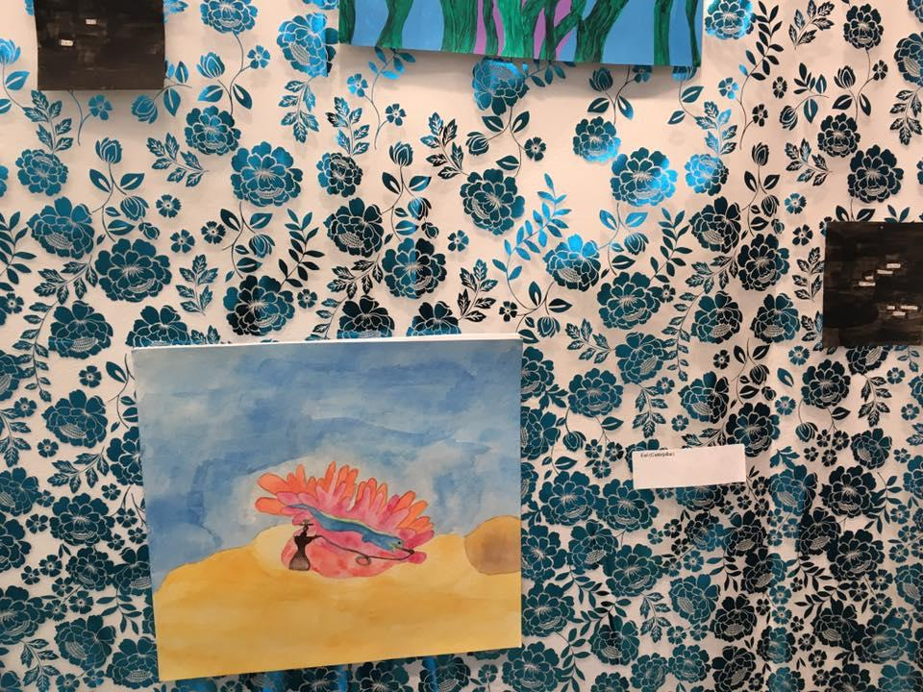
Alice Subaqueous Contd

Slide 5
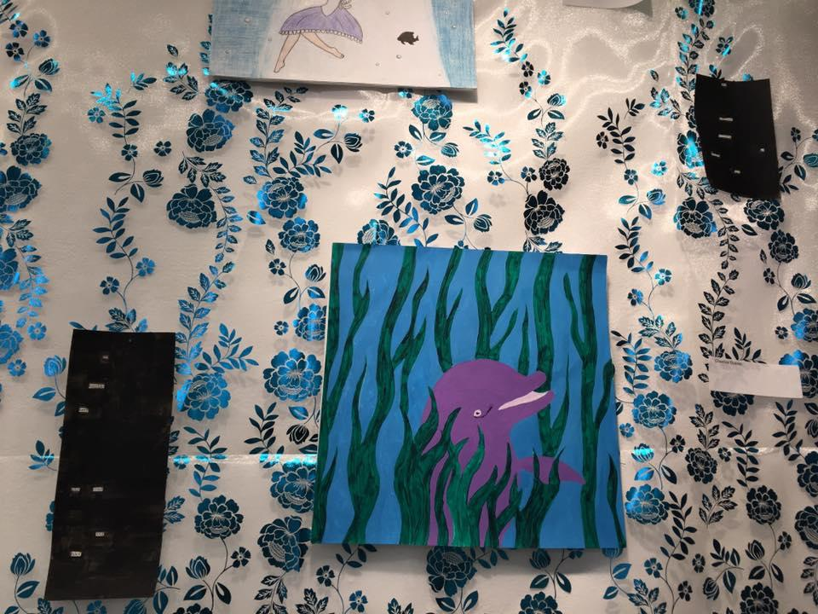
Alice Subaqueous Final
For this retrospective I chose to use multiple elements to create a central theme of an underwater fantasy. I used watercolor for the majority of pieces because I never had experience with the medium prior and it was pleasing to learn the techniques with it. I used music for a background to give a whimsical ambience when people observe my work. The poetry was an added element that I decided to do after I found a book on the history of Alice Liddell, the girl who inspired Lewis Carroll to write Alice in Wonderland. I chose to use an underwater theme because I’ve always been fascinated by the ocean and I thought it would be a neat twist on the classic story.

